Slide 1

US HEALTHCARE ANALYSIS

Slide 2
Health Condition Insights: Gender Based Analysis
Key Insights:
Hypertension is the most prevalent condition (61% of the total cases).
Male Population is more prone to medical conditions like Hypertension and asthma.
Obesity is significantly higher in female population (62 %) indicating potential lifestyle or biological factors.
Arthritis and asthma show a near equal gender split with arthritis slightly more common in females and asthma in males.
Cancer affects both the genders equally.(836 Females vs 811 Males)
Notes:
WE CAN ADD NOTES HERE

Slide 3
Health condition Insights: Blood Group Based Analysis
Key Insights :
Hypertension is the most common condition (2155 cases), with B+ having the highest cases (282).
Cancer cases are evenly distributed across blood groups, ranging from 189 to 218.
Obesity is highest in AB- (239) and lowest in B+ (182).
Arthritis cases are fairly balanced, with AB+ (219) showing the highest count.
Asthma is most common in A+ and O+ (210 each).
Diabetes cases are lowest in O+ (155) and highest in B- (197).
All blood groups have a near-equal share in total cases (~12.5%).

Slide 4
Admission Type Analysis
Key Insights:
Emergency cases have the highest revenue
share ($87 M) and highest average billing amount ($24,279), with an increase of 4% from the overall average.
Elective admissions contributes almost
$70.9 M with an average billing amount $23,029, slightly lower (-1%) than the overall average.
Urgent cases generates $75.8 M revenue but with a lower (-3%) average billing amount i.e. $22,731.
Balanced distribution among admission types, but cost variation suggests different resource utilization.

Slide 5
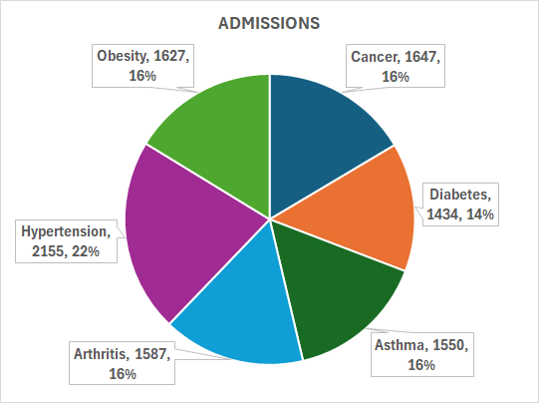
Medical condition Analysis
Cancer patients on an average pay 70% more ($ 39677) than the overall average billing amount.
Hypertension admissions are around 22% of the total admissions but has an average billing amount of $ 17,643 which is 25% lower than the overall average.
Lowest admissions are from diabetes ( 14% ) yet the average billing amount ($ 30070) is 29% higher than the overall average.
Obesity, Asthma and Arthritis show fairly equal admissions whereas obesity has a lower average billing amount($ 12,536) which is almost half of the overall average.

